Slide 1
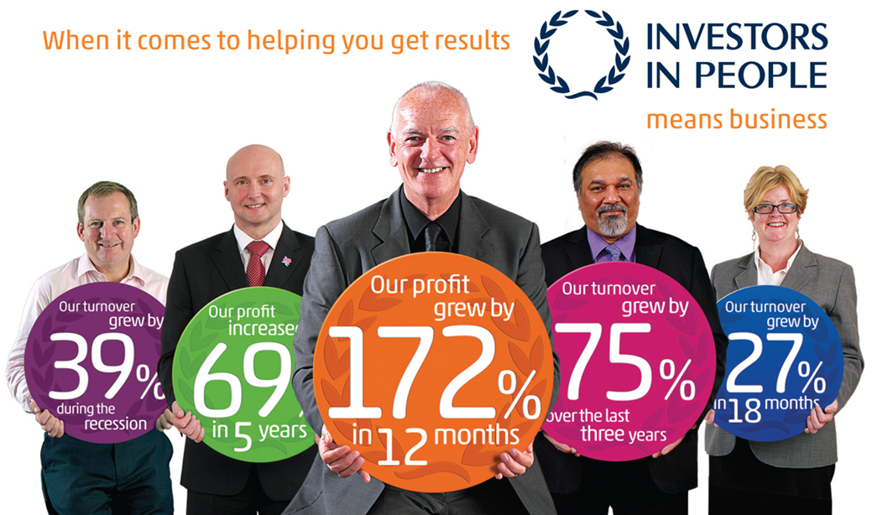
Creating a People Strategy

Slide 2
Objective
To be able to create a people strategy for your organisation

Slide 4
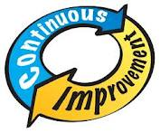
Investors in People Themes

Slide 5
Does managing people better improve results?

Slide 6
Business need
People

Slide 7
The 5 Step Model
Business priorities
Gap analysis
Building organizational capability
Actions so far
Future action plan

Slide 8
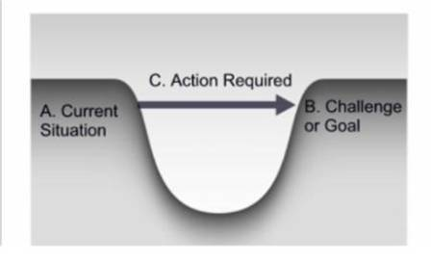
The Investors in People Survey

Slide 9
Report items

Slide 10
Working with the Standard
People strategy workshop
Free learning sessions
Online support
Members login and access to resources
Discount on employee survey
Access to Investors in People discussion forum
Investors in People Certificate

Slide 11
What next
Send in your strategy for feedback
Log in to the members section of the website
Send questions through email or chat
Come to members learning events

